Slide 1
Variation in Foliar Functional Traits across Environmental Gradients in ABoVE Landscapes
Phil Townsend, UW-Madison
Ryan Pavlick, JPL PI
Eric Kruger, UW-Madison
Chip Miller, JPL
Dave Schimel, JPL

Slide 2
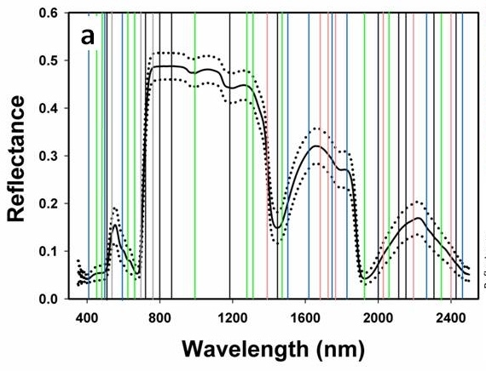
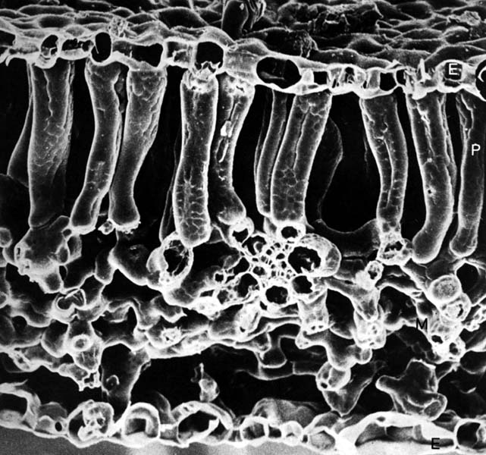
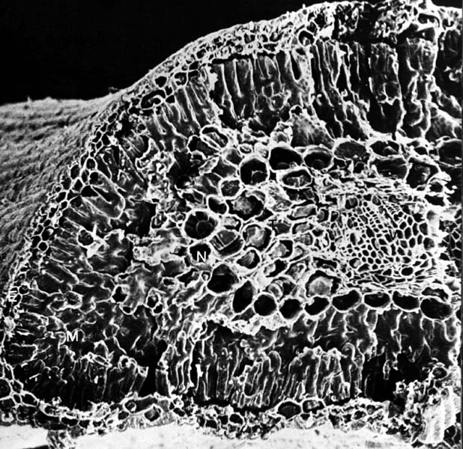
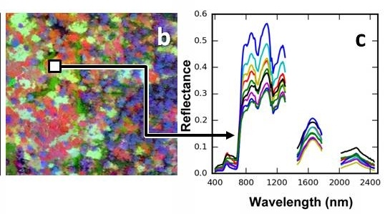
Objectives: Vegetation Change
Foliar Functional Traits
Ecosystem Structure
and Function
Photosynthesis
CO₂ → carbohydrates
Nitrogen
Leaf Mass per Area (LMA)
Sugars and Starches
Chlorophyll, Pigments
Water
P, K, Ca, Mg
Decomposition
Structural Compounds
Lignin
Cellulose
Defense
Tannins
Phenolics
Notes:
Graphic sources:
By Kristian Peters -- Fabelfroh 09:12, 28 February 2007 (UTC) - photographed by Kristian Peters, CC BY-SA 3.0, https://commons.wikimedia.org/w/index.php?curid=1725761
https://micro.magnet.fsu.edu/cells/leaftissue/leaftissue.html
http://friendslaarb.org/tree/swamp-chestnut-oak
https://treesofsantacruzcounty.blogspot.com/2011/03/quercus-agrifolia-coast-live-oak.html
https://pxhere.com/en/photo/428178

Slide 3
Remote Sensing
AVIRIS-NG Imagery
Trait Mapping
Need for consistent processing

Slide 4
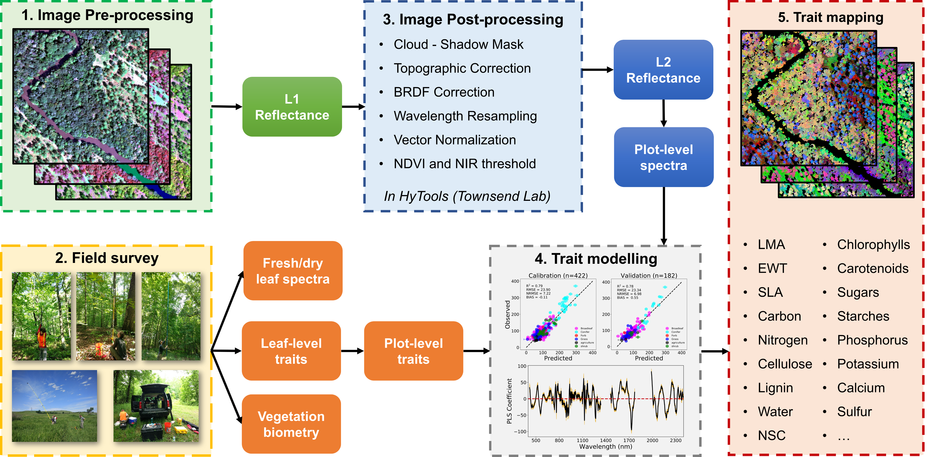
Methods / Field Studies
Products:
1) Maps of Traits + Uncertainties; 2) BRDF/topo corrected AVIRIS
3) Functional diversity characterization

Slide 5
[Stakeholder] Engagement
Federal / state / territory agencies [Polar]
Links to NEON
Data sharing!
Data for Cal/Val are essential
Adding lichens and bryophytes
Opportunities for modeling
Rethinking PFTs in Arctic/boreal

